Slide 1
Modelling and Simulation of Hospital Management
Varaprasad Kurra
Sravanthi Malepati

Slide 2
Agenda
Problem Statement and Background
Modelling and Simulation goals
Overview and Description
Demo
Results
Conclusion

Slide 3
Problem Statement and Background
One of the key issues in the HealthCare system is managing the hospital resources. Particularly utilizing the Doctors to treat different patients.
Many models have come to address this issue in different fields of Computer Science discipline. For example Data Analytics, Operations Research etc.
But to give a visual explanation of how to address the issues in the HealthCare system, Modelling and Simulation is most helpful.
We aim to address the queuing issue of the patients and utilizing the doctor resources optimally.

Slide 4
Modelling and Simulation Goals
Our modelling goal is to model a Hospital system that will help to utilize the resources of the hospital like doctors etc.
We aim to handle the dynamic flow of patients by utilizing the doctor resource so as to help in treating the patient.
So Modelling and Simulation goals is to draft a M&S system to handle the queuing of patients and utilize the doctors in treating the patients depending upon the condition [say Normal Patient or Emergency Patient].

Slide 5
Overview and Description
Two categories of patients namely Normal Patients who come for Annual Physical or general treatment and Emergency Patients who needs doctor care immediately.
We have used a Data Structure to hold the patient's inflow and then adjust the patients' list depending upon the condition.
An Emergency Patient will be added to first place and will be assigned a doctor at the earliest.
A component called receptionist will hold the Doctor’s and Patient’s information and finally a controller component coordinates with doctors and receptionist.

Slide 6
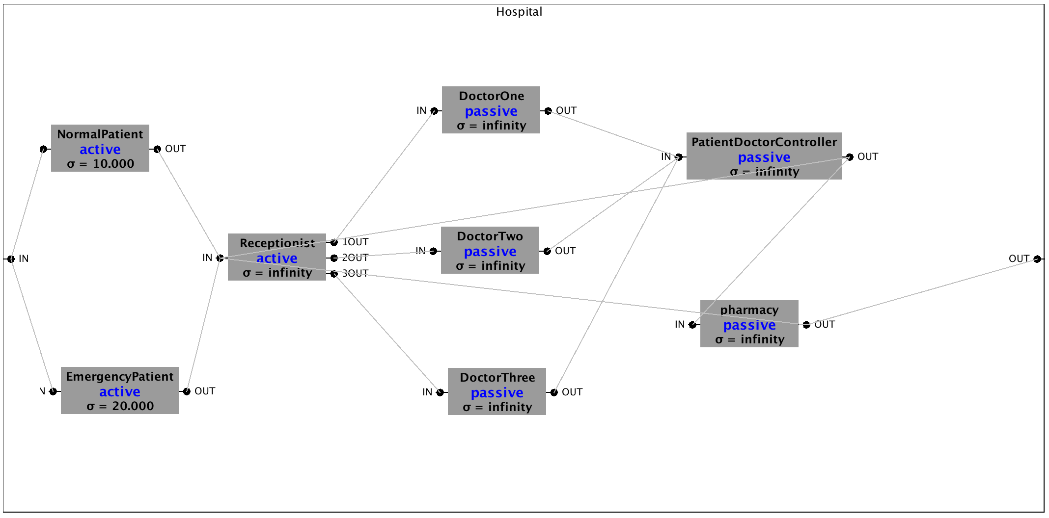
Simulation Model

Slide 7
Demo

Slide 8
Results :
We see that patients are queued at Receptionist component. The sorting of the patients is done depending upon the condition of the patient.
This model will help the patients with the highest priority to get consulted first with the available doctor.
PatientDoctorController is the key component that manages and coordinates the flow of patients by connecting doctors to patients.

Slide 9
Conclusion:
With its applications in different fields Modelling & Simulation can be adopted as an visuallying concept to track, understand and model an optimal solution.
M&S diagrammatic representations will be helpful to understand how we can optimally draft a solution to the problem.

